Slide 1

Heads up! Vigilance behavior in American crows
Alex Popescu
Supervised by Dr. Kiyoko Gotanda
Brock University

Slide 2
What have I been up to? Conferences
Brock's GRaD Conference (September)
SQEBC 2022 at UQO (October)
CSEE/ESA 2022 Joint Annual Meeting (August)
ASU SEEP workshop 2022 (May)
Brock’s MNK Conference (April)
Notes:
Integrating society, ecology, evolution, and plasticity to advance urban evolutionary ecology

Slide 3
What have I been up to? Student life at Brock
Biology graduate student representative
Testing a scientific communication module with VPMI
VP of events at GRAMSS
Happy Hour
Pumpkin Carving Contest
Midwinter Social
Attempted to create an ecology module for LabLinks at Brock University

Slide 4
What have I been up to? Community work
SpeedQB
“Paintball”
Introduced young and old players to a new style of play
Organized two events that attracted players from the Southern Ontario region
Setting up a league for 2023
Great feedback from the community & had the opportunity to use my communication skills in a non-academic setting.

Slide 5
What have I been up to? Future Collaboration
Summer 2023
Crow Genoscape
Collection of feathers in St. Catharines, Montreal and Quebec city
Trial run in June
Data collection in July-August
This is will depend wholly on the status on my thesis!

Slide 6
Scoping review
Database searched (WoS)
Title and Abstract screening completed
Field research
Field season complete
Full-text screening nearing completion
Researching how to conduct a meta-analysis and extract data
Videos coded
Data analyzed
What have I been up to?
Thesis
Notes:
Numbers

Slide 7
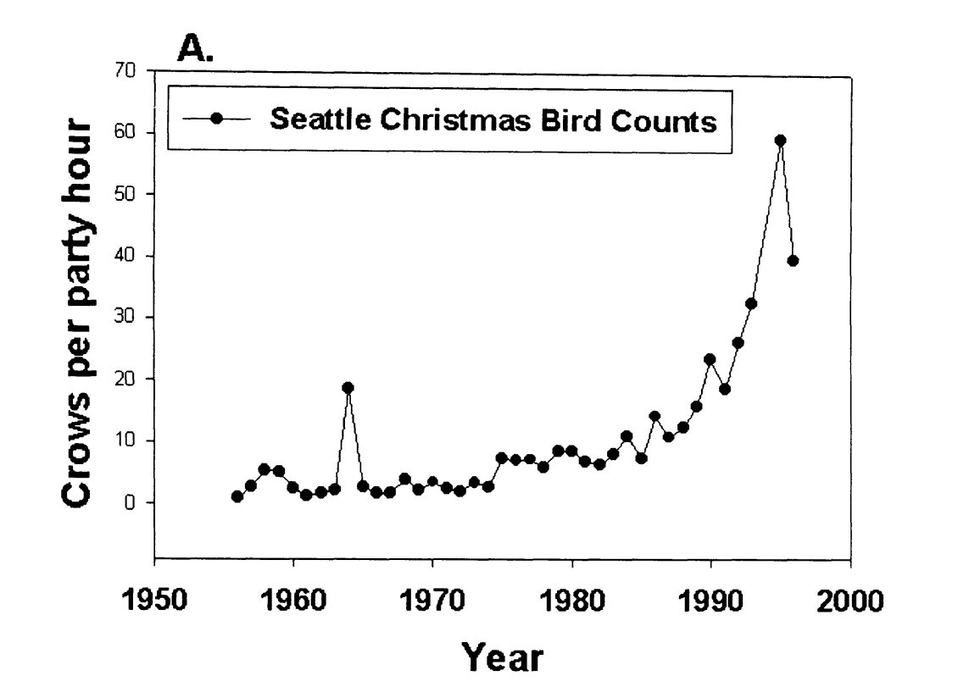
Some background information
Crows have been increasing in abundance in urban settings.
Urbanized
What makes them so successful?
Individual behavioral adaptations
Changes in foraging behavior
Decreased neophobia
Increased tameness towards humans
Marzluff et al.(2001). Avian Ecology and Conservation in an Urbanizing World || Causes and consequences of expanding American Crow populations.

Slide 8
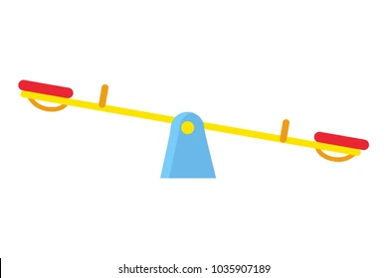
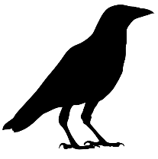
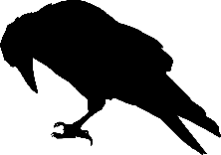
Some background information
What about social behavioral adaptations?
Social behaviors play into the trade-off between foraging efficiency and vigilance.
Too much is like not enough…
Vigilance
Foraging efficiency
↑ Risk of starvation
↑ Risk of predation

Slide 9
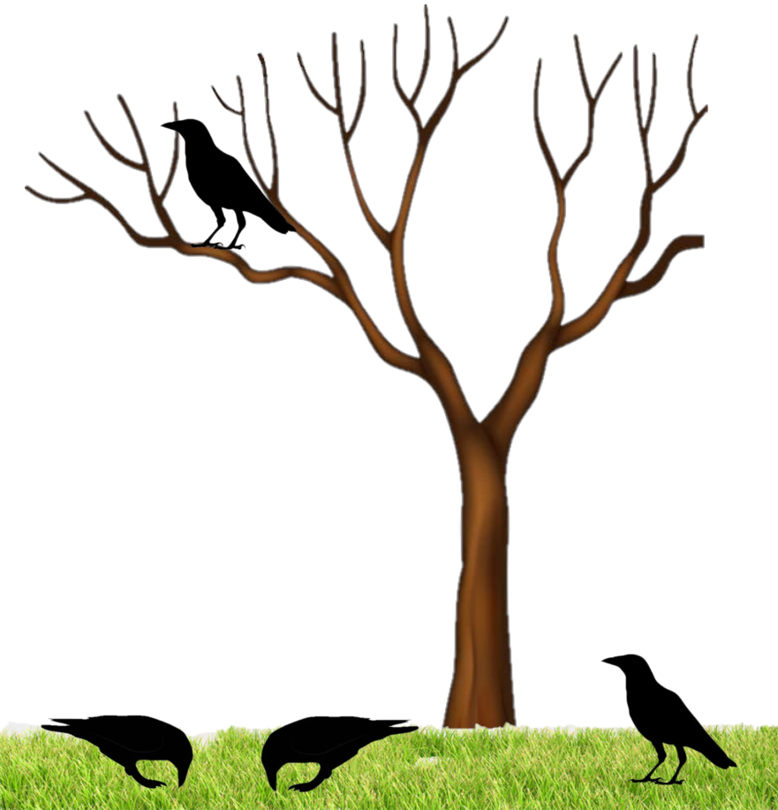
Some background information
Sentinel behavior is a type of social foraging behavior.
Sentinels (A) are constantly vigilant, providing security to the foraging members, but at a great cost to the sentinel.
Could this contribute to the success of crows in urban areas?
A
Social
Individual
B

Slide 10
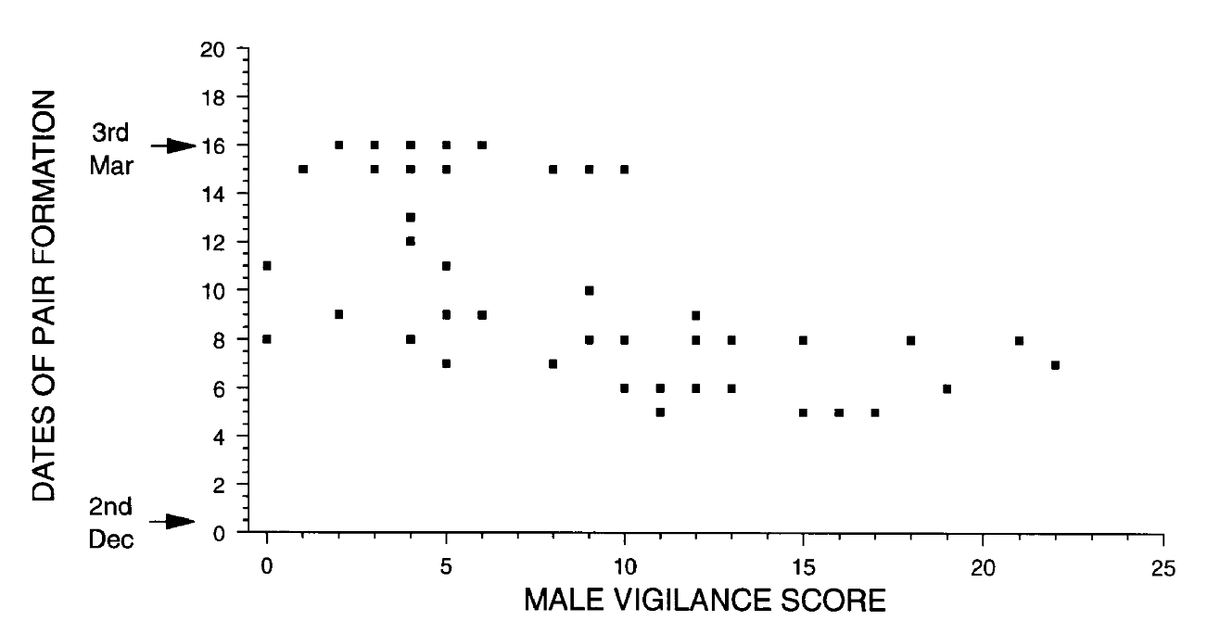
Sentinel behavior
Sentinel behavior is affected by multiple factors:
Sex
Dominance
Pair status
Age
Sentinel behavior as a type of sexual display.
↑ vigilance = ↑ success = better mate choice
From L. Beani and F. Dessì-Fulgheri (1998) in Grey Partridges
Vigilance decreased after pair formation.

Slide 11

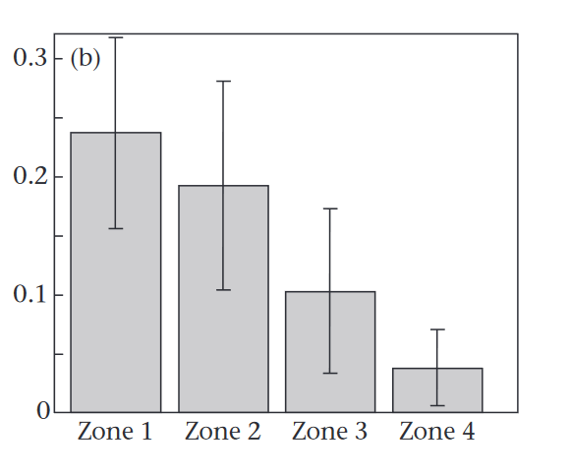
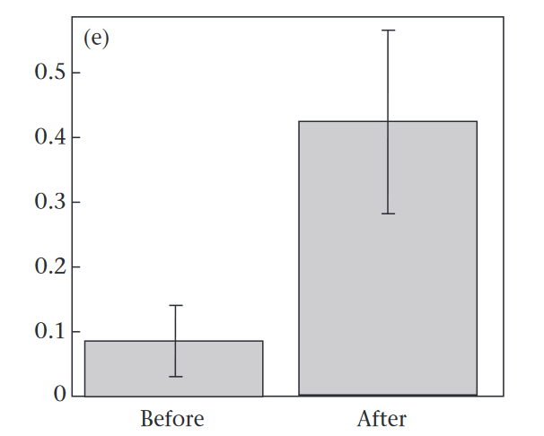
Sentinel behavior
What about risk of predation?
↑ risk = ↑ need for vigilance
Increased risk of predation causes an increase in frequency of sentinel behavior.
Mean number of sentinel bouts per session in response to increased risk of predation (b, Zone 1 = High predation, Zone 4 = Low predation) and in response to spotting a predator (e) in chestnut-crowned babblers.
From E. Sorato et al. 2012

Slide 12
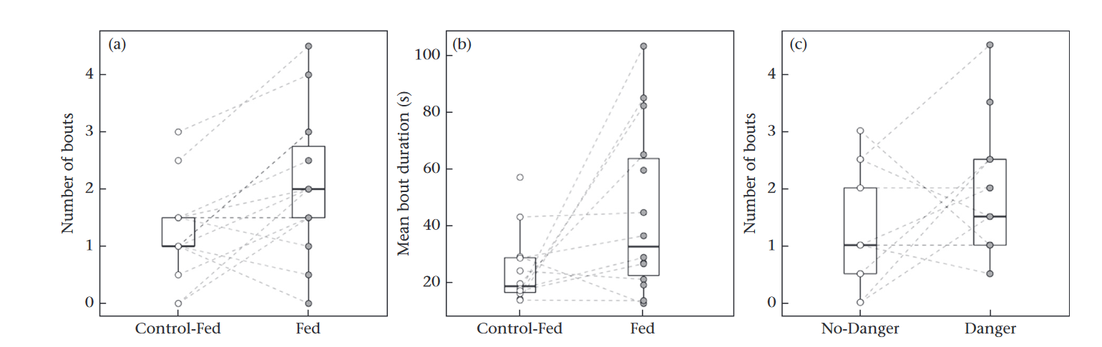
Sentinel behavior
From J. J. Arbon et al. (2020) in dwarf mongooses
And satiation?
↑ satiation = ↓ need to forage
Well-fed individuals can be sentinels for longer and more often.

Slide 13
Sentinels and urban settings
Urban settings are expected to increase the likelihood of sentinel behavior
Increased access to food = ↑ Satiation
Presence of urbanized predators and humans = ↑ Risk
Abundant locations for sentinels to perch on
In turn, sentinels are expected to decrease the individual vigilance of foragers.

Slide 14
My objective
To determine whether and how individual vigilance while foraging is affected by the presence of a sentinel and the environment in which the individual forages in.
I expect foraging individuals to be less vigilant in the presence of a sentinel but be more vigilant in commercial areas.

Slide 15

The scoping review
The objective of the scoping review remains the same:
To identify factors that can affect sentinel behavior in terrestrial and avian species
Its purpose:
To help me better explain what I observe in the field

Slide 16
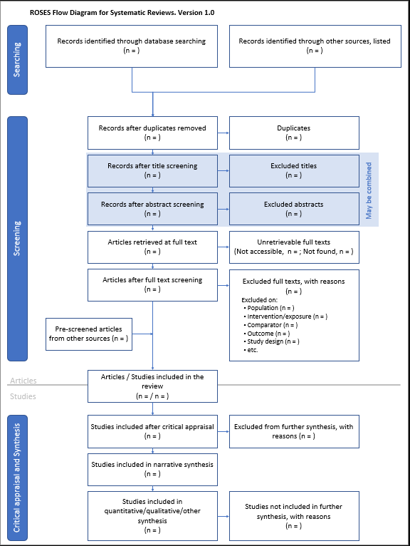
Methodology Scoping review
I am following the ROSES workflow.
Searched Web of Science Complete using:
"Sentinel AND Behavio*"
Haddaway NR, Macura B, Whaley P, and Pullin AS. 2017. ROSES flow diagram for systematic reviews. Version 1.0. DOI: 10.6084/m9.figshare.5897389
Notes:
Generation of keywords and refining of search queries
Collection of results from multiple databases (Scopus, Web of Science, Google Scholar, grey literature)
Collection and analysis of data, if available, from search results
Synthesis of available knowledge
Generation of predictions & expected outcomes

Slide 17
Methodology Scoping review
Excluded articles from unrelated fields of study and journals (e.g. Journal of Sleep Research) NOT Optimal
Excluded irrelevant areas of research in WoS.
Excluded articles not written in English.
No need for de-duplication.
Haddaway NR, Macura B, Whaley P, and Pullin AS. 2017. ROSES flow diagram for systematic reviews. Version 1.0. DOI: 10.6084/m9.figshare.5897389
Notes:
Generation of keywords and refining of search queries
Collection of results from multiple databases (Scopus, Web of Science, Google Scholar, grey literature)
Collection and analysis of data, if available, from search results
Synthesis of available knowledge
Generation of predictions & expected outcomes

Slide 18
Search Strings – How not to do it
V1: (TS=(sentinel AND Behavio*)) AND ((LA==("ENGLISH") AND SJ==("BEHAVIORAL SCIENCES" OR "ZOOLOGY" OR "ENVIRONMENTAL SCIENCES ECOLOGY" OR "NUTRITION DIETETICS" OR "REPRODUCTIVE BIOLOGY" OR "BIODIVERSITY CONSERVATION" OR "WATER RESOURCES" OR "ACOUSTICS" OR "EVOLUTIONARY BIOLOGY" OR "COMMUNICATION" OR "DEVELOPMENTAL BIOLOGY" OR "URBAN STUDIES") AND DT==("ARTICLE" OR "ABSTRACT" OR "REVIEW" OR "UNSPECIFIED")) NOT (SILOID==("MEDLINE") OR SO==("SLEEP ROCHESTER" OR "SLEEP" OR "REMOTE SENSING" OR "JOURNAL OF SLEEP RESEARCH" OR "ENVIRONMENTAL BIOLOGY OF FISHES" OR "MEDICINE AND SCIENCE IN SPORTS AND EXERCISE" OR "MEDICINE SCIENCE IN SPORTS EXERCISE" OR "NEUROPSYCHOPHARMACOLOGY" OR "DRUG DEVELOPMENT RESEARCH" OR "JOURNAL OF TROPICAL ECOLOGY" OR "KOELLA W P ED SLEEP 1982 PHYSIOLOGY PHARMACOLOGY SLEEP FACTORS MEMORY SLEEP DEPRIVATION HYPNOTICS 6TH EUROPEAN CONGRESS ON SLEEP RESEARCH ZURICH MARCH 23 26 1982 XIV 435P S KARGER BASEL SWITZERLAND NEW YORK N Y USA ILLUS" OR "PSYCHOLOGICAL RECORD" OR "REVIEWS IN FISH BIOLOGY AND FISHERIES" OR "ALCOHOLISM CLINICAL AND EXPERIMENTAL RESEARCH" OR "ELECTROENCEPHALOGRAPHY AND CLINICAL NEUROPHYSIOLOGY" OR "FRONTIERS IN MARINE SCIENCE" OR "EVOLUTION AND HUMAN BEHAVIOR" OR "AMERICAN JOURNAL OF TROPICAL MEDICINE AND HYGIENE" OR "BEHAVIOR THERAPY" OR "CANADIAN JOURNAL OF FISHERIES AND AQUATIC SCIENCES" OR "CURRENT DIRECTIONS IN PSYCHOLOGICAL SCIENCE" OR "HUMAN PSYCHOPHARMACOLOGY" OR "REMOTE SENSING OF ENVIRONMENT" OR "HUMAN PSYCHOPHARMACOLOGY CLINICAL AND EXPERIMENTAL" OR "COMPUTERS IN HUMAN BEHAVIOR" OR "ZEITSCHRIFT FUR TIERPSYCHOLOGIE JOURNAL OF COMPARATIVE ETHOLOGY" OR "ZEITSCHRIFT FUER TIERPSYCHOLOGIE" OR "TRANSPORTATION RESEARCH PART F TRAFFIC PSYCHOLOGY AND BEHAVIOUR" OR "ECOLOGICAL MODELLING" OR "FRESHWATER BIOLOGY" OR "AMERICAN JOURNAL OF PHYSICAL ANTHROPOLOGY" OR "BULLETIN OF THE PSYCHONOMIC SOCIETY" OR "COGNITIVE THERAPY AND RESEARCH" OR "PSYCHOPHYSIOLOGY" OR "ERGONOMICS" OR "HYDROBIOLOGIA" OR "EUROPEAN JOURNAL OF SOCIAL PSYCHOLOGY" OR "HERRMANN W M ED ELECTROENCEPHALOGRAPHY IN DRUG RESEARCH PROCEEDINGS OF THE SYMPOSIUM BERLIN WEST GERMANY JUNE 27 29 1980 XIX 608P BUTTERWORTHS WOBURN MASS USA GUSTAV FISCHER VERLAG STUTTGART NEW YORK N Y USA ILLUS" OR "IEEE JOURNAL OF SELECTED TOPICS IN APPLIED EARTH OBSERVATIONS AND REMOTE SENSING" OR "IEEE TRANSACTIONS ON GEOSCIENCE AND REMOTE SENSING" OR "INDUSTRIAL HEALTH" OR "SLEEP STUTTGART" OR "JOURNAL OF VETERINARY BEHAVIOR CLINICAL APPLICATIONS AND RESEARCH" OR "INTERNATIONAL JOURNAL OF REMOTE SENSING" OR "JOURNAL OF COMPARATIVE PHYSIOLOGY A SENSORY NEURAL AND BEHAVIORAL PHYSIOLOGY" OR "JOURNAL OF FISH BIOLOGY" OR "JOURNAL OF PSYCHOPATHOLOGY AND BEHAVIORAL ASSESSMENT" OR "JOURNAL OF ZOO AND AQUARIUM RESEARCH" OR "MARINE AND FRESHWATER RESEARCH" OR "PERSONAL RELATIONSHIPS" OR "JOURNAL OF CLINICAL AND EXPERIMENTAL NEUROPSYCHOLOGY" OR "PERCEPTUAL AND MOTOR SKILLS" OR "EUROPEAN NEUROPSYCHOPHARMACOLOGY" OR "MARINE ECOLOGY PROGRESS SERIES" OR "PSYCHOPHARMACOLOGY") OR MC==("POPULATION STUDIES" OR "NEURAL COORDINATION" OR "ENDOCRINE SYSTEM" OR "POLLUTION ASSESSMENT CONTROL AND MANAGEMENT" OR "MOVEMENT AND SUPPORT" OR "MATHEMATICAL BIOLOGY" OR "EQUIPMENT APPARATUS DEVICES AND INSTRUMENTATION" OR "OCCUPATIONAL HEALTH" OR "TRANSPORT AND CIRCULATION" OR "COMPUTER APPLICATIONS" OR "AGING" OR "ECONOMICS" OR "ENZYMOLOGY" OR "INFORMATION STUDIES" OR "RADIOLOGY" OR "CLINICAL IMMUNOLOGY" OR "RADIATION BIOLOGY" OR "DERMATOLOGY" OR "SOCIOLOGY" OR "GASTROENTEROLOGY" OR "ONCOLOGY" OR "PHILOSOPHY AND ETHICS" OR "SURGERY" OR "URINARY SYSTEM" OR "UROLOGY" OR "CLINICAL ENDOCRINOLOGY" OR "HEMATOLOGY" OR "PALEOBIOLOGY" OR "PHARMACOGNOSY" OR "CARDIOVASCULAR SYSTEM" OR "MEDICAL SCIENCES" OR "PEDIATRICS" OR "PUBLIC HEALTH" OR "INGESTION AND ASSIMILATION" OR "PATHOLOGY" OR "BIOGEOGRAPHY" OR "NERVOUS SYSTEM" OR "COMPUTATIONAL BIOLOGY" OR "HUMAN MEDICINE MEDICAL SCIENCES" OR "MODELS AND SIMULATIONS" OR "AGRICULTURE" OR "MARINE ECOLOGY" OR "ANTHROPOLOGY" OR "BIOCHEMISTRY AND MOLECULAR BIOPHYSICS" OR "MOLECULAR GENETICS" OR "INTEGUMENTARY SYSTEM" OR "VECTOR BIOLOGY" OR "VETERINARY MEDICINE" OR "GERIATRICS" OR "DIGESTIVE SYSTEM" OR "HORTICULTURE" OR "SANITATION" OR "SPORTS MEDICINE" OR "AGRICHEMICALS" OR "ALLERGY" OR "BIOGRAPHY" OR "BIOMEDICAL ENGINEERING" OR "BIOPROCESS ENGINEERING" OR "CLINICAL IMMUNOLOGY HUMAN MEDICINE MEDICAL SCIENCES" OR "EDUCATION" OR "AQUACULTURE" OR "CLINICAL CHEMISTRY" OR "PHARMACOLOGY" OR "CHEMICAL COORDINATION AND HOMEOSTASIS" OR "PSYCHIATRY" OR "NEUROLOGY" OR "PHYSIOLOGY" OR "FRESHWATER ECOLOGY" OR "ALLIED MEDICAL SCIENCES" OR "DENTAL AND ORAL SYSTEM" OR "CELL BIOLOGY" OR "BLOOD AND LYMPHATICS" OR "SKELETAL SYSTEM" OR "RESPIRATORY SYSTEM" OR "RESPIRATION" OR "MUSCULAR SYSTEM" OR "EXOBIOLOGY" OR "GYNECOLOGY" OR "HISTORY" OR "HOSPITAL ADMINISTRATION" OR "HUMAN MEDICINE" OR "NEPHROLOGY" OR "NURSING" OR "PULMONARY MEDICINE" OR "SEROLOGY" OR "SOIL SCIENCE" OR "WASTE MANAGEMENT" OR "MEMBRANES" OR "IMMUNE SYSTEM" OR "CARDIOVASCULAR MEDICINE" OR "TOXICOLOGY" OR "ECONOMIC ENTOMOLOGY")))
Horrible to work with and missed articles of interest.

Slide 19
Search Strings – The right way
V2: ((TS=(sentinel AND Behavio*)) AND ((LA==("ENGLISH")))) AND ((SJ==("BEHAVIORAL SCIENCES")) NOT (SJ==("HEALTH CARE SCIENCES SERVICES" OR "PEDIATRICS" OR "PHARMACOLOGY PHARMACY" OR "MARINE FRESHWATER BIOLOGY" OR "GENERAL INTERNAL MEDICINE" OR "METEOROLOGY ATMOSPHERIC SCIENCES" OR "SUBSTANCE ABUSE" OR "CRIMINOLOGY PENOLOGY" OR "RADIOLOGY NUCLEAR MEDICINE MEDICAL IMAGING" OR "SURGERY" OR "MEDICAL LABORATORY TECHNOLOGY" OR "PUBLIC ENVIRONMENTAL OCCUPATIONAL HEALTH“ OR "WOMEN APOS S STUDIES" OR "GEOCHEMISTRY GEOPHYSICS" OR "RESEARCH EXPERIMENTAL MEDICINE" OR "IMAGING SCIENCE PHOTOGRAPHIC TECHNOLOGY" OR "EDUCATION EDUCATIONAL RESEARCH “ OR "BUSINESS ECONOMICS" OR "BIOTECHNOLOGY APPLIED MICROBIOLOGY")))
Much better results – 364 results on Nov. 1 2022 on WoS Complete

Slide 20
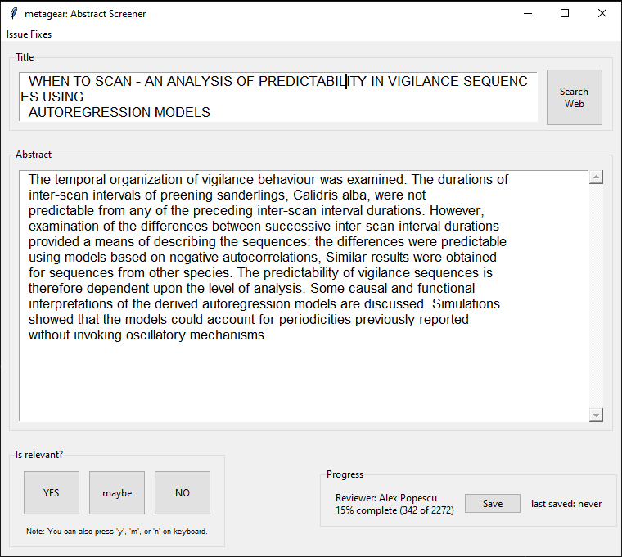
Methodology Scoping review
Performed article/abstract screening in R using Metagear.
Lajeunesse Lab is still a great resource!
Following their methodology for meta-analysis and synthesis.
Metagear GUI while screening SorVandB in R
Notes:
Generation of keywords and refining of search queries
Collection of results from multiple databases (Scopus, Web of Science, Google Scholar, grey literature)
Collection and analysis of data, if available, from search results
Synthesis of available knowledge
Generation of predictions & expected outcomes

Slide 21
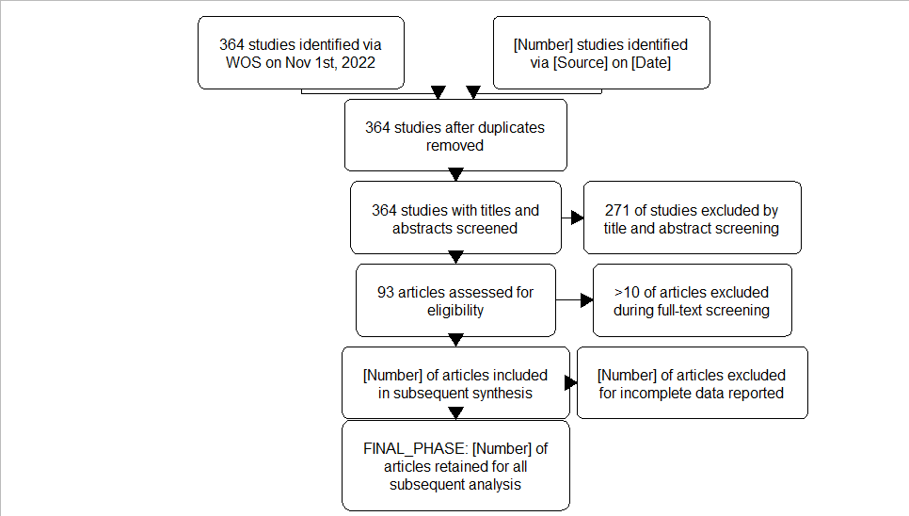
Methodology Scoping review
271 articles excluded
93 articles retained
Screened three times and nearly done full-text screening.
Prisma workflow of "Sentinel AND Behaviour"
Notes:
Generation of keywords and refining of search queries
Collection of results from multiple databases (Scopus, Web of Science, Google Scholar, grey literature)
Collection and analysis of data, if available, from search results
Synthesis of available knowledge
Generation of predictions & expected outcomes

Slide 22
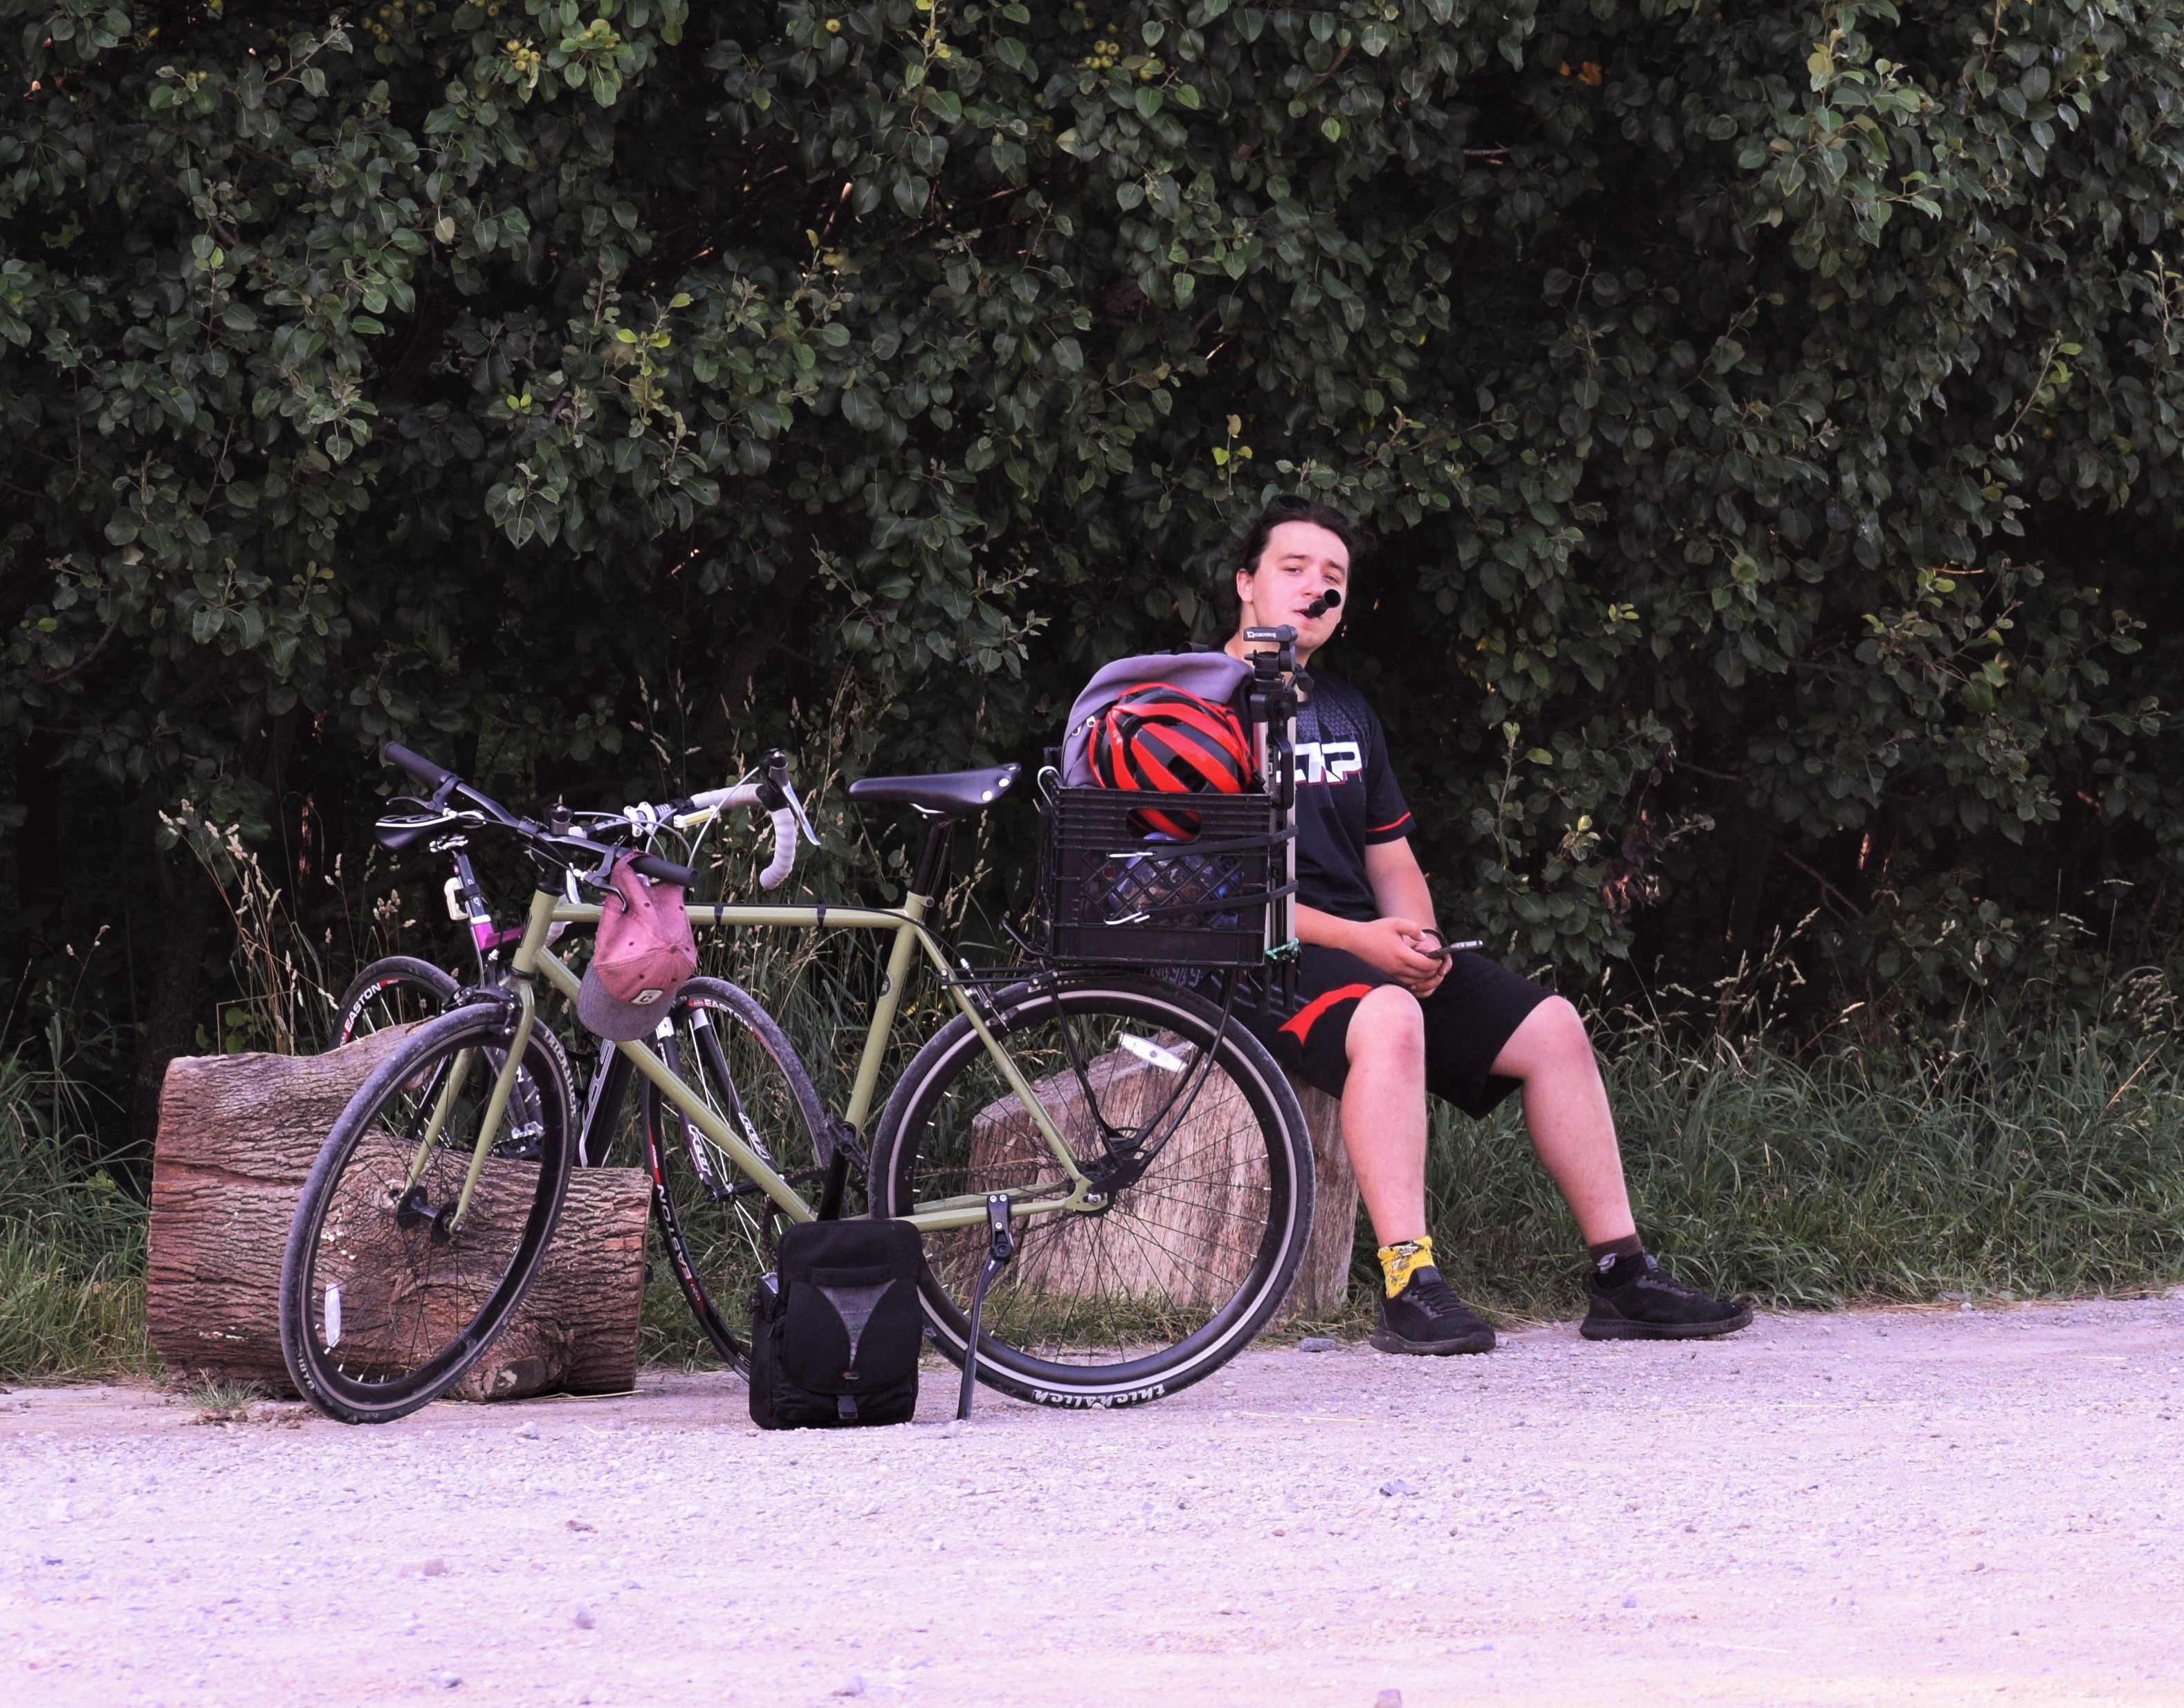
Methodology: Field Research
Combination of baited sites and opportunistic baiting.
25 videos recorded from May to September.

Slide 23
Methodology: Field Research Timeline of observations
Arrive on-site -> 5min setup
Set up camera, place bait, return to camera
Record for 20 minutes, then leave for another site
Stay 10 minutes after crows have left if bait was not fully consumed
When leaving, leave 5 peanuts in-shell if no foraging occurred. If opportunistic site, then no peanuts were left.

Slide 24
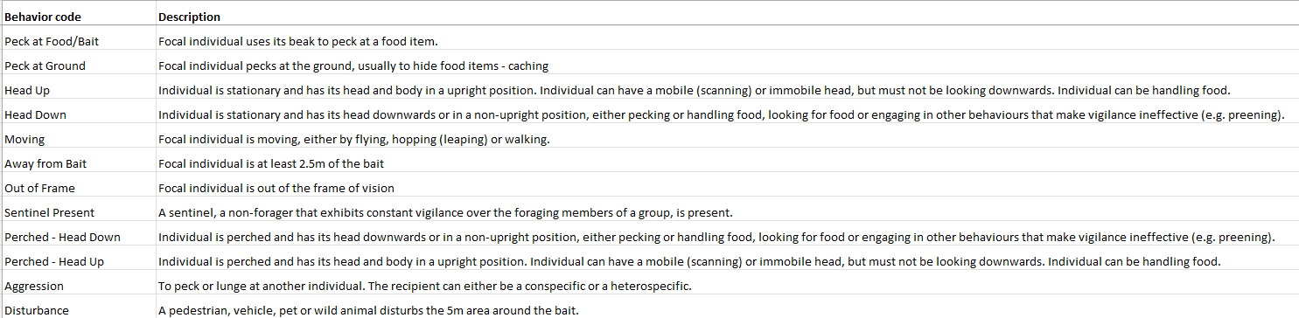
Ethogram
Went through a couple more version versions in response to feedback received at meetings with Dr. Clark’s lab and at conferences.

Slide 25
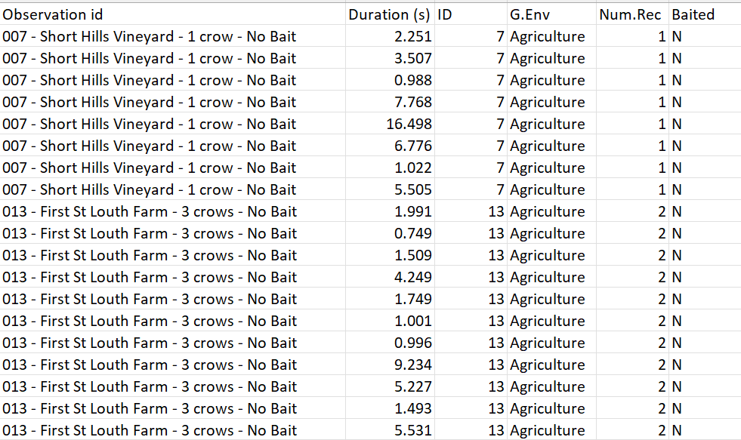
Raw Data

Slide 26
Results
Main test used: Linear Mixed Models (Robust or generalized)
Fixed Effects:
Behavior
Presence of a sentinel
Generalized environment
Number of recorded crows
Whether the site was baited
Random Effect:
ID

Slide 27
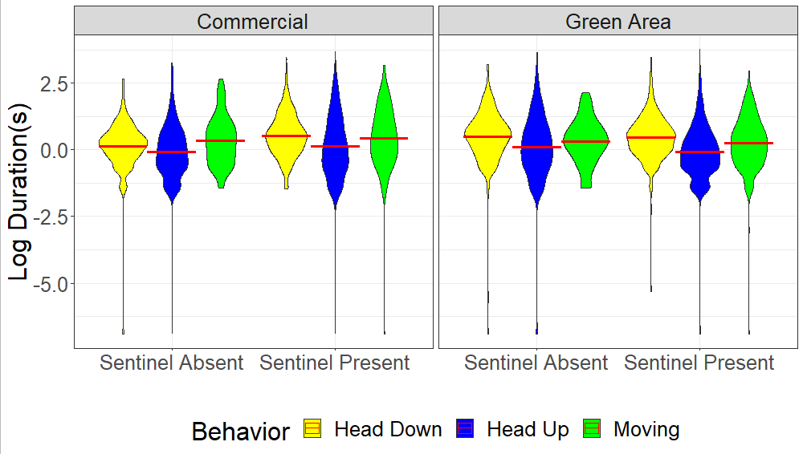
Duration of behaviors
Duration with head up is lower than all other behaviors.

Slide 28
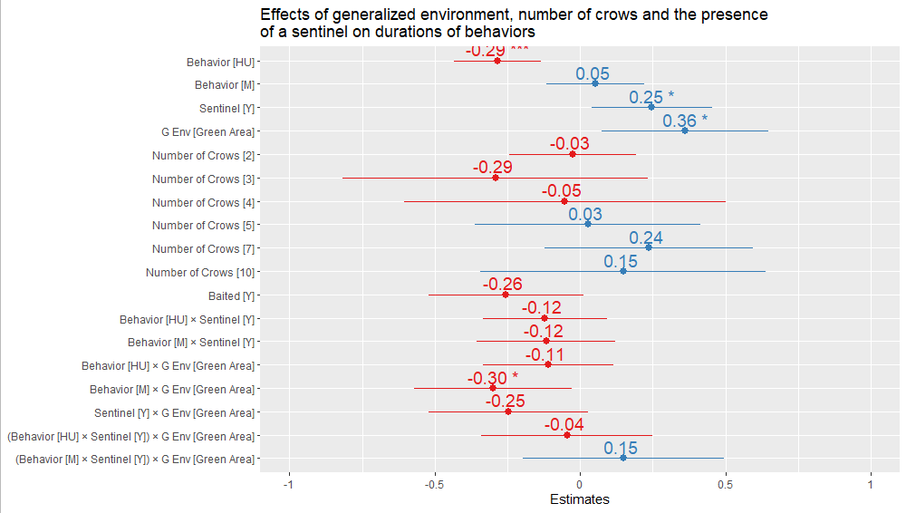
Duration of behaviors – Effect Sizes
A robust LMM revealed multiple significant effects, with both positive and negative effects.

Slide 29
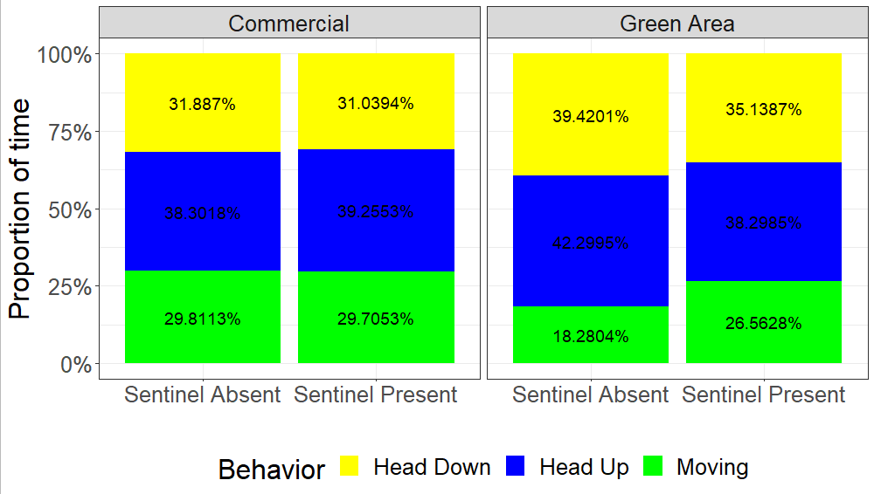
Proportion of time
Similar to duration of behaviors, the proportion of time moving in green areas appears reduced.
Notes:
Arcsin(sqrt()) transformation

Slide 30
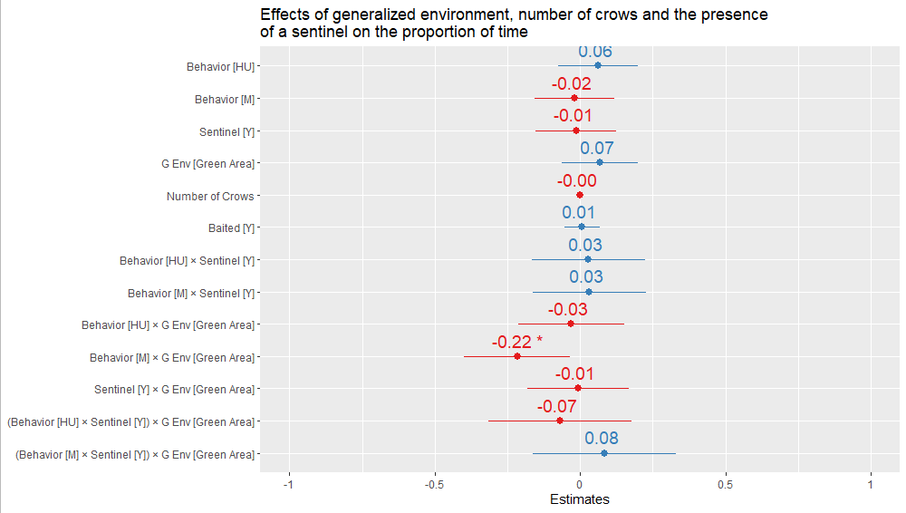
Proportion of time – Effect Sizes
Indeed, the proportion of time moving in green areas was significantly reduced. No other effects significant.
Notes:
Arcsin(sqrt()) transformation

Slide 31
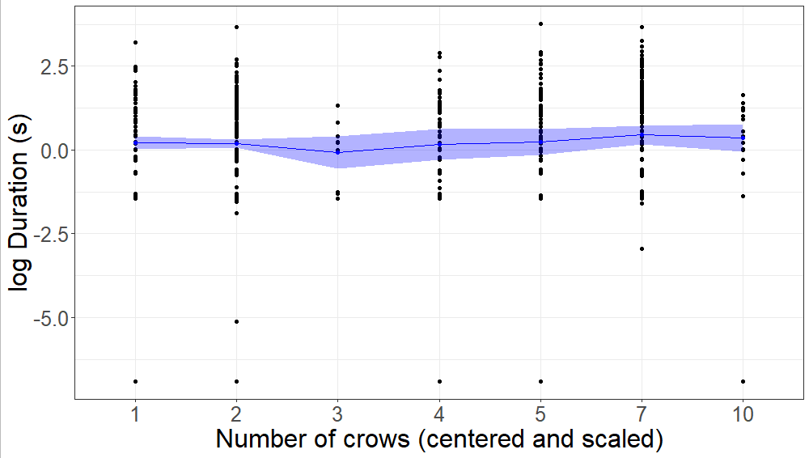
What about group size?
The data does not follow the model’s predicted effects. Group size does not affect the HU duration.

Slide 32
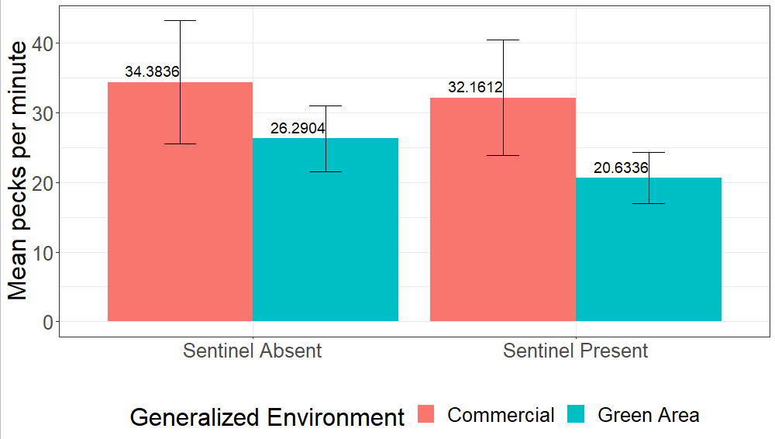
Pecks per minute
Appears as if crows pecked more frequently in commercial areas, but a GLMM revealed no significant effects.
Notes:
Error bars are SEM

Slide 33
My conclusions
Head Up duration was significantly reduced, but the proportion of time was not
Moving duration and proportion of time in green areas was significantly reduced
The presence of sentinels significantly increased the duration of behaviors
Group size had no effect on duration or proportion of behaviors
There were no significant effects on peck rate

Slide 34
My conclusions
My objective was to determine whether and how individual vigilance while foraging is affected by the presence of a sentinel and the environment in which the individual forages in.
The presence of a sentinel increased the duration of behaviors, but does not change how much time an individual allocates to either vigilance or foraging behaviors
Green areas had a significant positive effect on duration overall, but significantly decreased ‘moving’ duration and proportion.

Slide 35
Future Endeavors
Thesis outline
Finish reading all the articles for the scoping review
Extract data and perform a meta-analysis on the results from the articles
Write the methodology section in December

Slide 36
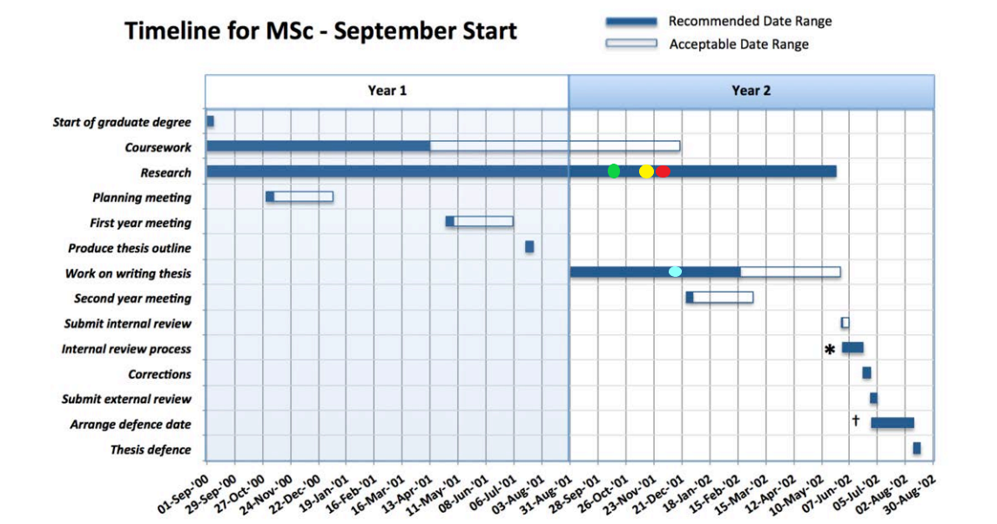
Timeline
Thesis outline must be finished
Writing to commence immediately
Next meeting in March

Slide 37
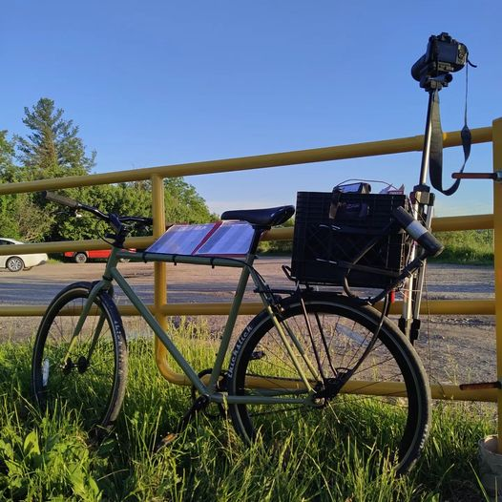
I greatly appreciate your feedback and constructive criticism

